Slide 1
Classical Music: An Exploration of Timeless Artists

Slide 2

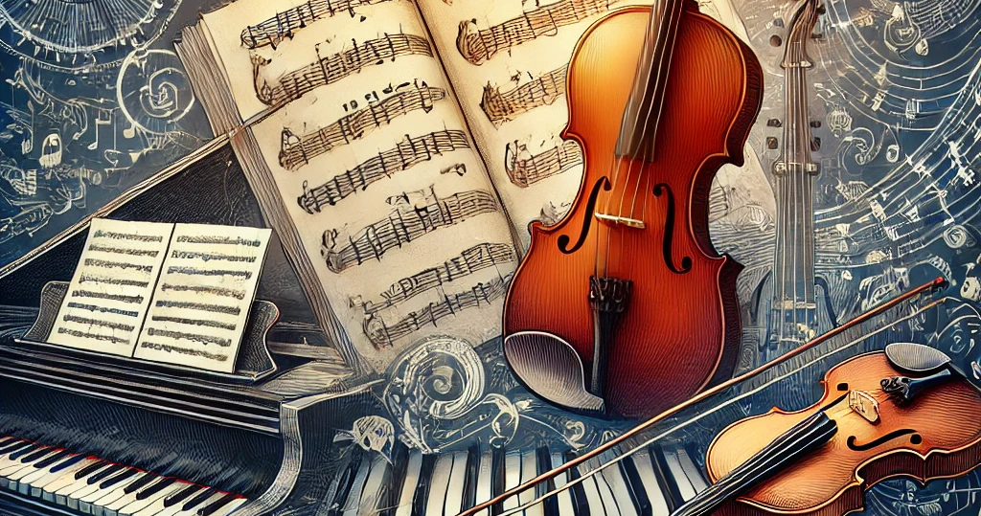
What is Classical Music?
Classical music is A broad term that usually refers to the music composed in the traditions of western liturgical and secular music from roughly the 11th century to the present day. It encompasses A wide range of styles and periods, including the medieval, renaissance, baroque, classical, romantic, and modern eras. This genre is characterized by its highly structured form, use of orchestral instruments, and its reliance on written scores for performance. Renowned for its complexity and emotional depth, classical music has produced many of the most enduring and influential compositions and artists in musical history

Slide 3
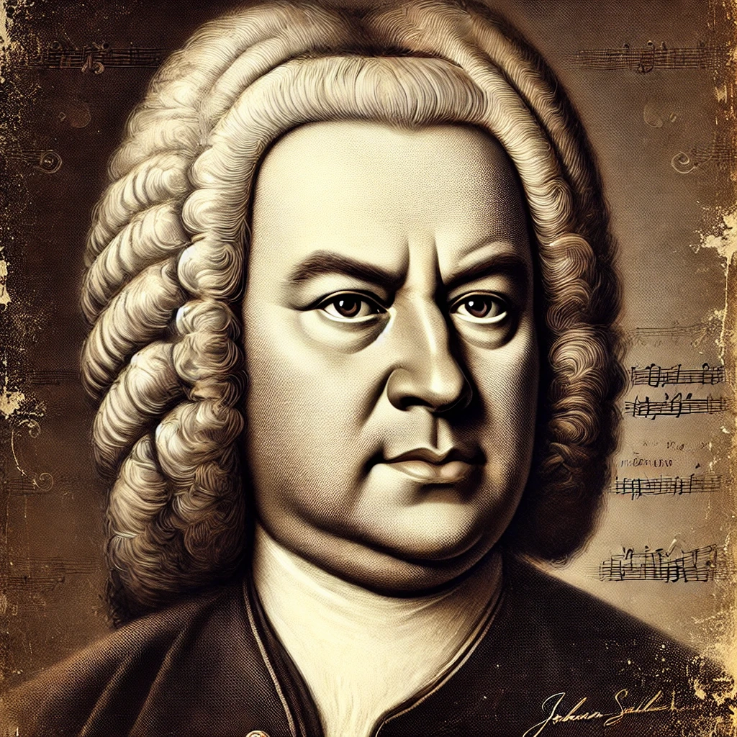
Johann Sebastian Bach(1685-1750)
German composer and musician of the baroque period.
- Known for instrumental compositions such as the brandenburg concertos and the goldberg variations.
- His vocal music includes the st matthew passion and the mass in b minor.
- Bach's music is revered for its technical command, artistic beauty, and intellectual depth.

Slide 4
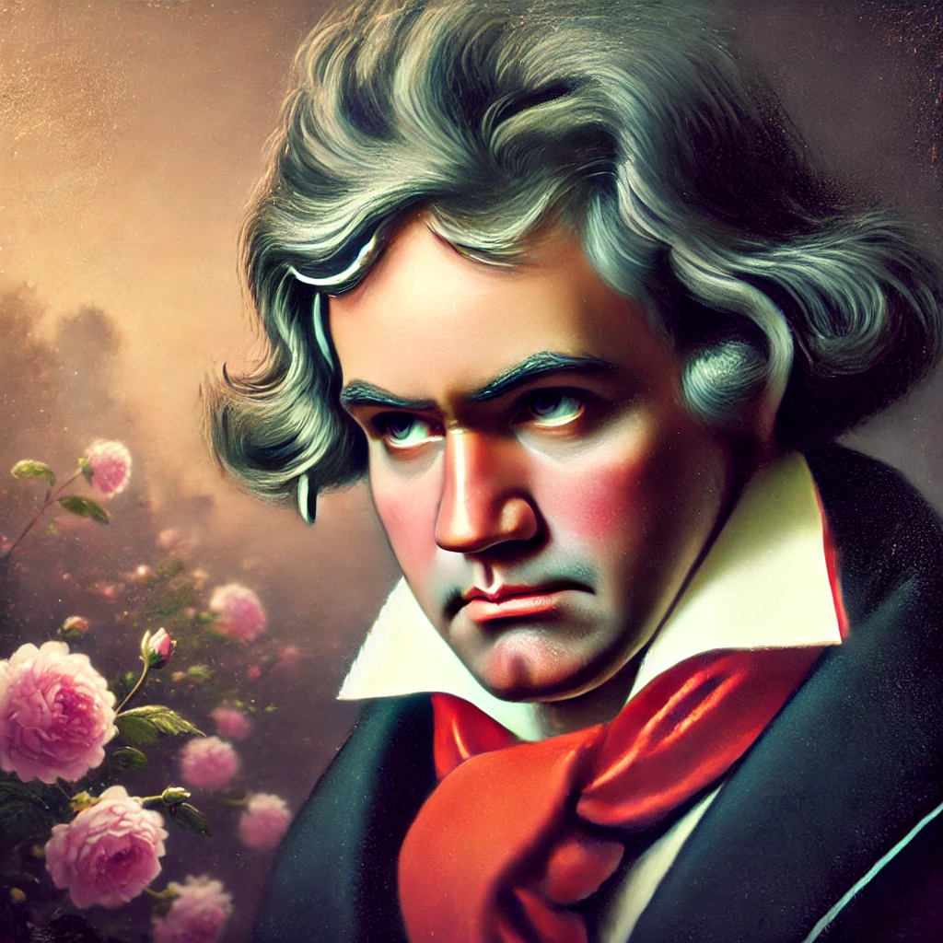
Ludwig van Beethoven(1770-1827)
German composer and pianist. - Crucial figure in the transition between the classical and romantic eras.
- Known for his symphonies, sonatas, and string quartets. - His most famous works include symphony no. 9, moonlight sonata, and für elise.
- Despite losing his hearing, beethoven composed some of his greatest works during his later years

Slide 5
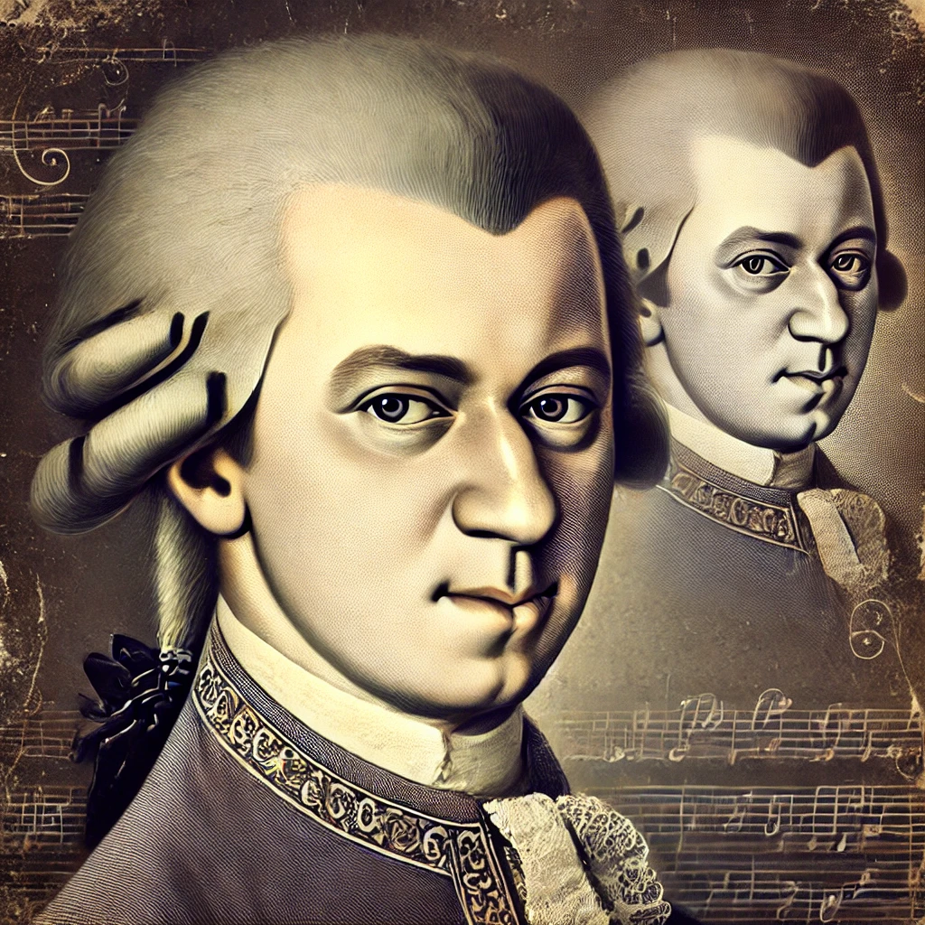
Wolfgang Amadeus Mozart (1756-1791)
- Prolific and influential composer of the classical era.
- Composed over 600 works, including symphonies, operas, chamber music, and choral music. - Known for masterpieces such as the magic flute, don giovanni, and requiem.
- His music is noted for its melodic beauty, formal perfection, and emotional depth

Slide 6
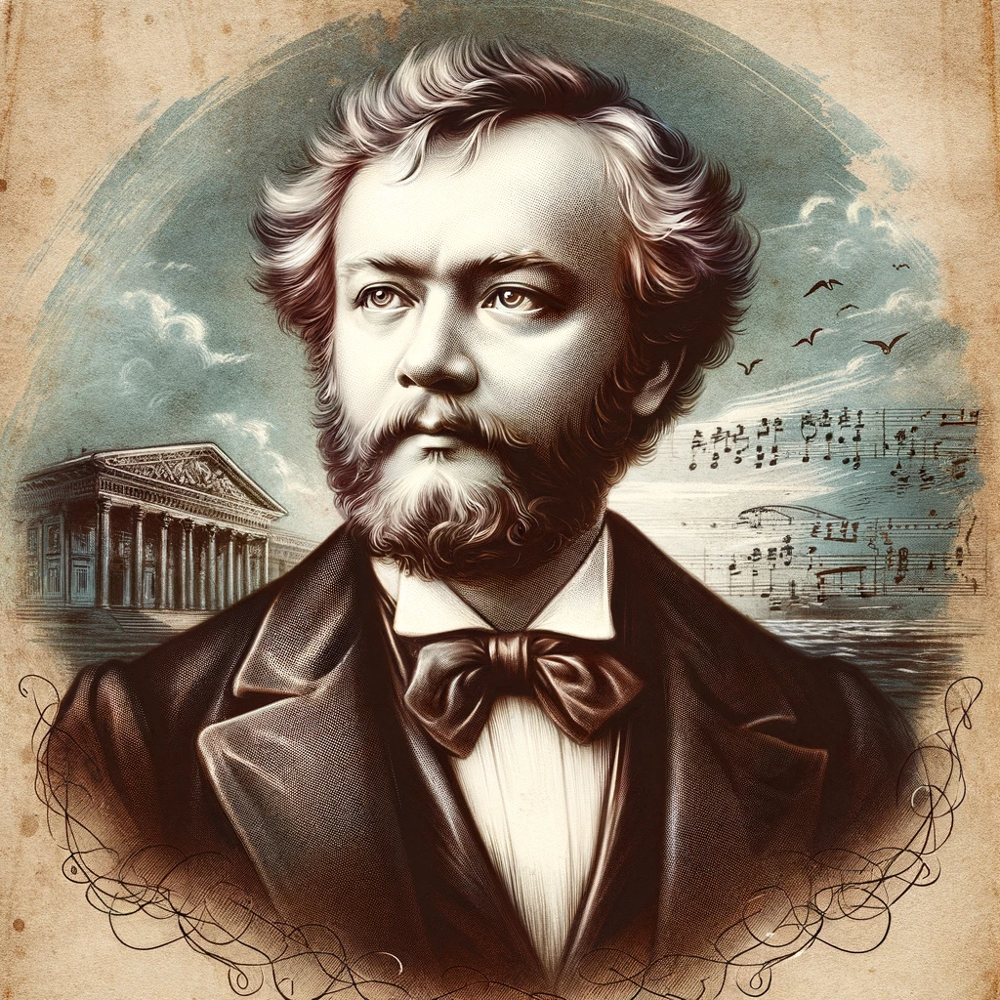
Pyotr llyich Tchaikovsky(1840-1893)
- Russian composer of the romantic period. - Known for his symphonies, ballets, operas, and concertos. - Famous works include swan lake, the nutcracker, and symphony no. 6 (pathétique). - Tchaikovsky's music is celebrated for its tunefulness, originality, and emotional expressiveness. - Audio example: swan lake (https://www.Youtube.Com/watch?V=9rjob7y6ncs) - russian composer of the romantic period.
- Known for his symphonies, ballets, operas, and concertos.
- Famous works include swan lake, the nutcracker, and symphony no. 6 (pathétique).
- Tchaikovsky's music is celebrated for its tunefulness, originality, and emotional expressiveness.
- Audio example: swan lake (https://www.Youtube.Com/watch?V=9rjob7y6ncs)

Slide 7
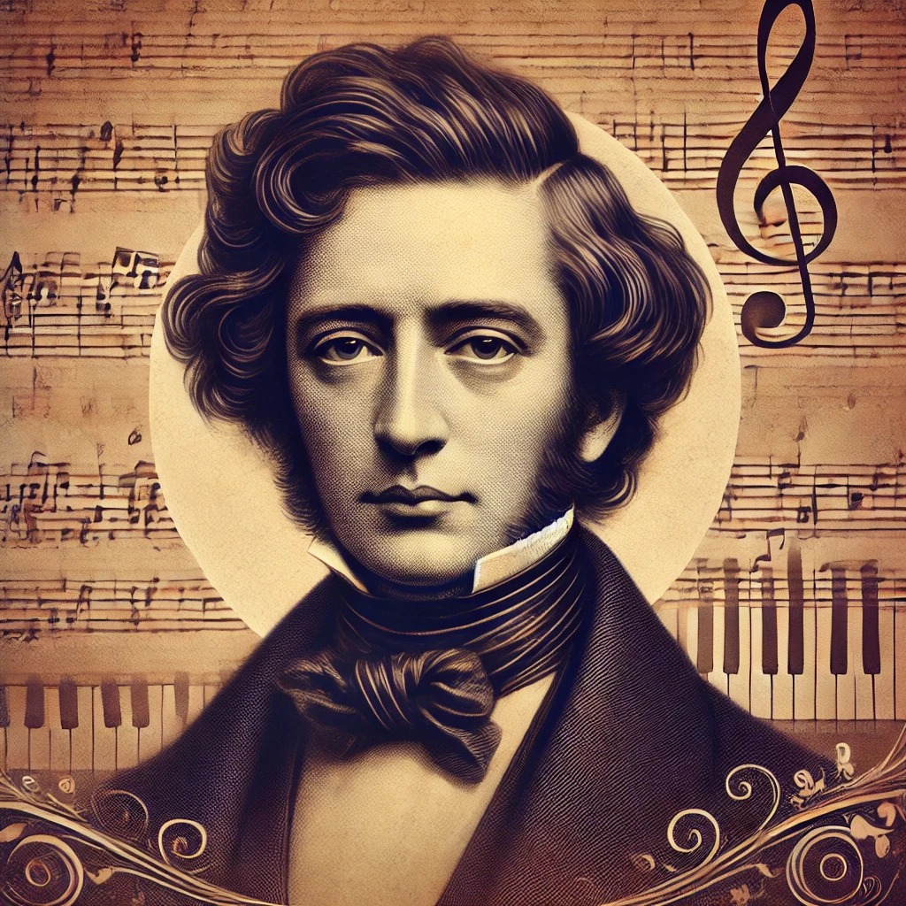
Frédéric Chopin (1810-1849)
Polish composer and virtuoso pianist of the Romantic era.
- Known for his solo piano compositions and piano concertos.
- His works include nocturnes, études, preludes, and polonaises.
- Chopin's music is characterized by its poetic brilliance, technical prowess, and nationalistic fervor.
- Audio Example: Nocturne Op. 9 No. 2 (https://www.youtube.com/watch?v=9E6b3swbnWg)

Slide 8
References
Bach, J. S. (1685-1750). Biography and works-
Beethoven, l. (1770-1827). Life and legacy.
- Mozart, w. A. (1756-1791). Compositions and influence.
Tchaikovsky, p. I. (1840-1893). Musical contributions.
- Chopin, f. (1810-1849). Pianist and composer.

